Slide 1
Fairfax County vs Russell County
Presentation By: Maria Terrazas, Mohidin Hassan

Slide 2
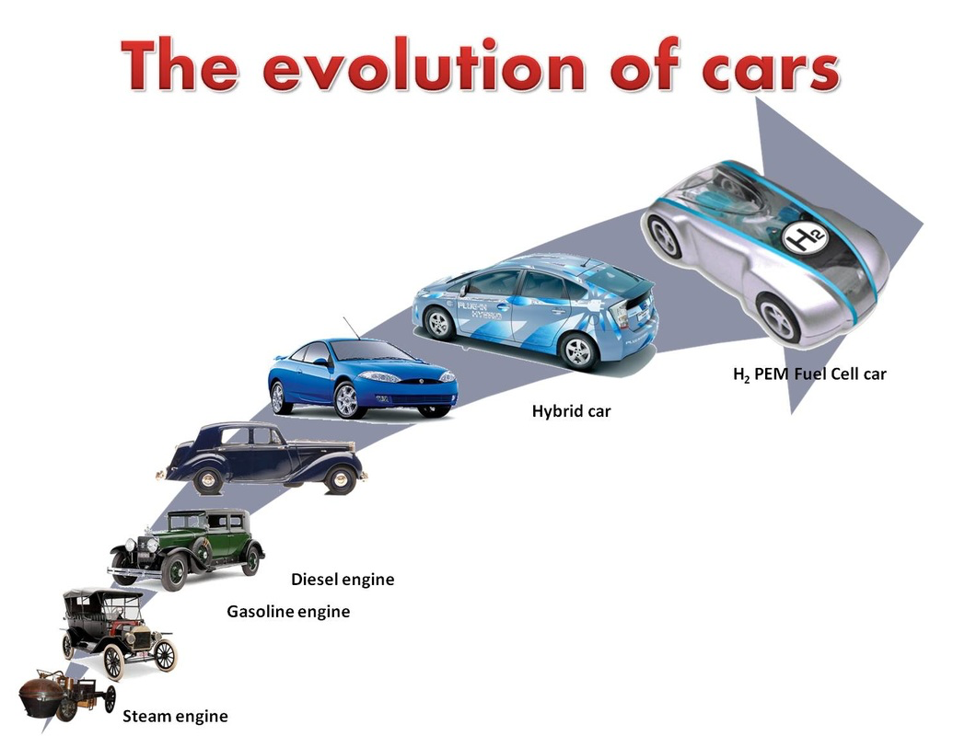

Evolution of Automobile
The first automobiles were developed in the late 1700s and were powered using steam which has been an energy source that had been used for many years at the time to power trains.
The first electrical car in the United States was built in 1890 by William Morrison.
In 1898, the first hybrid vehicle powered by electricity and gas was created by Ferdinand Porsche which became something revolutionary.
It was Karl Benz who invented the first gas-powered car in 1885 but at the time, the vehicle had only three wheels
The invention of the gas-powered automobile was so drastically important in America that it became the beginning of vehicular evolution in America.

Slide 3

Evolution of Automobile(continue)
At the time the late 80s-90s hit, automobile became modernized thanks to the advancement of technology
The newer automobiles had electric windows, doors, sunroofs and as well as CD players.
Did you know, the first turn signals were not added until 1939?

Slide 4
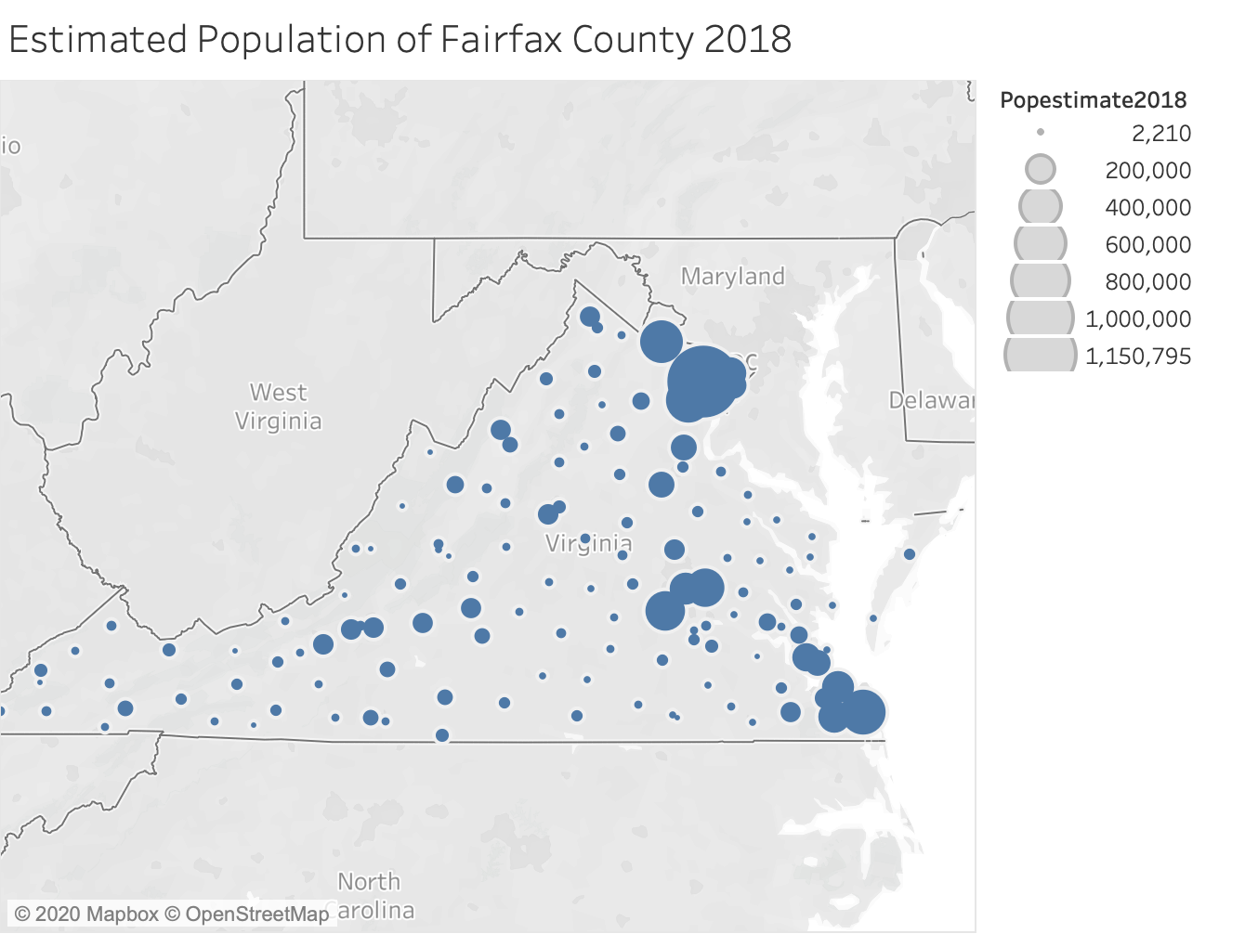
Background and History of Fairfax
Fairfax is one of the most populous areas in all of Virginia
With a population of around 1.15 million people, making up about
13% of the population in all of Virginia.

Slide 5
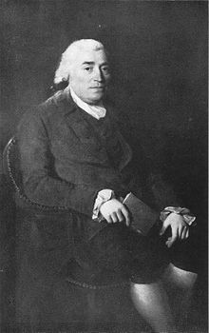
Background and History of Fairfax
Fairfax was formed in 1742 and it was named after Thomas Fairfax,
who was the “6th Lord Fairfax of Cameron”
Once was a part of Loudoun County, Arlington County, and Falls Church, but
Fairfax separated from all of them until around 1940.

Slide 6
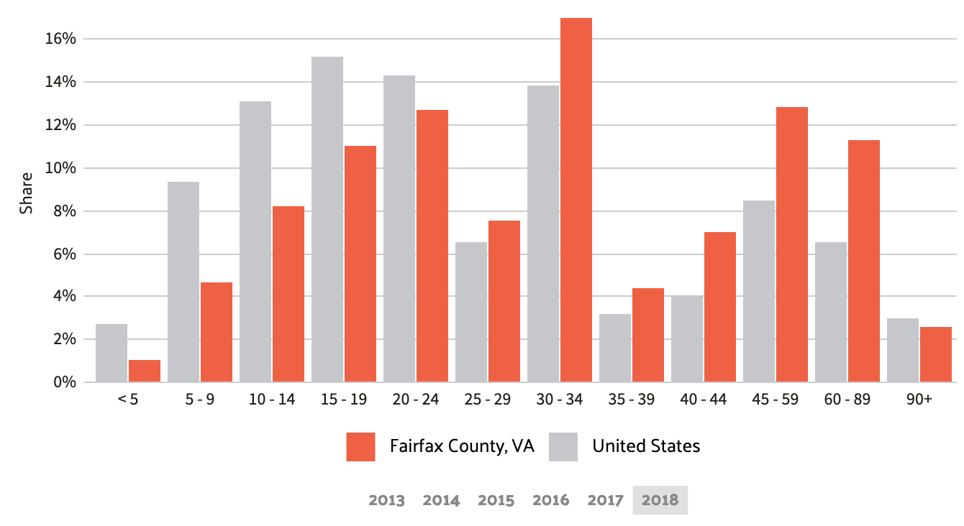
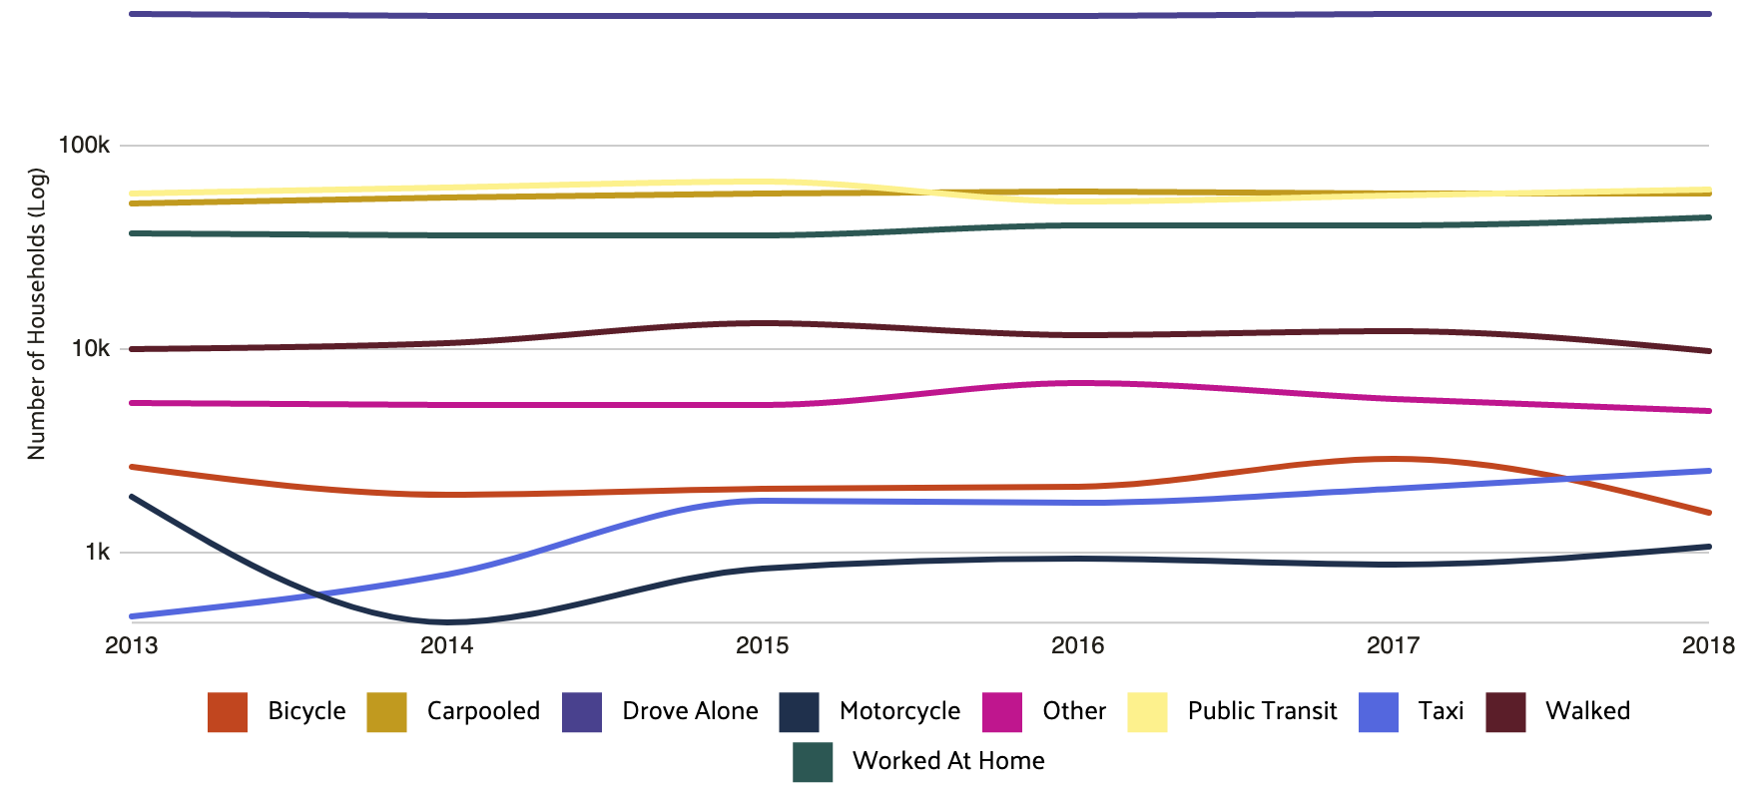
Commuting in Fairfax
County
Fairfax’s average commute time is around 30 minutes
Longer than the average worker’s commute time
(25 minutes). Most people preferred to commute by
driving alone

Slide 7
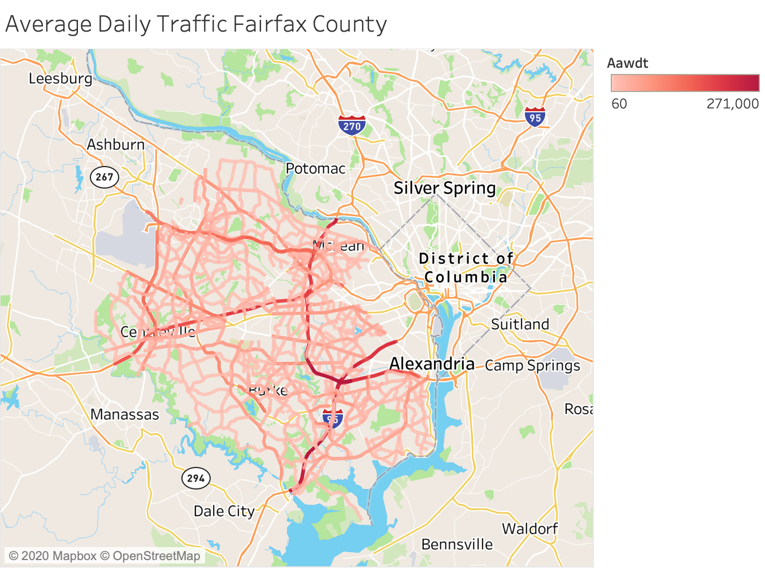
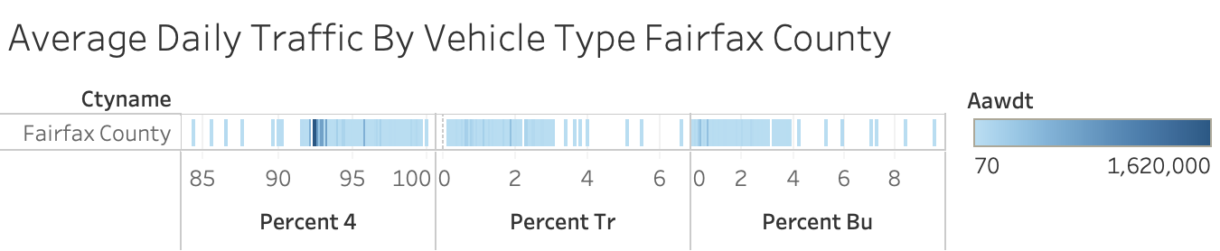
Traffic in Fairfax
The average daily traffic goes through I-95
Near Washington D.C. and also near Alexandria,
VA and Mclean, VA. The majority of traffic came
from 4-wheel vehicles whereas some of the
Traffic came from buses or trucks

Slide 8
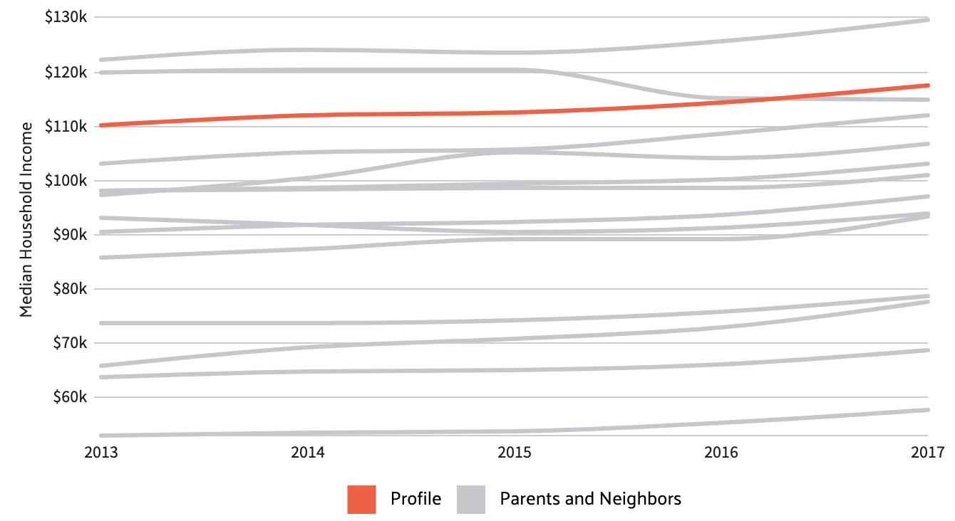
The Economy in Fairfax
Fairfax is one of the highest earning regions in the US,
with the average household earning roughly $122,000,
followed by Loudoun County, Arlington County, and
Falls Church.

Slide 9
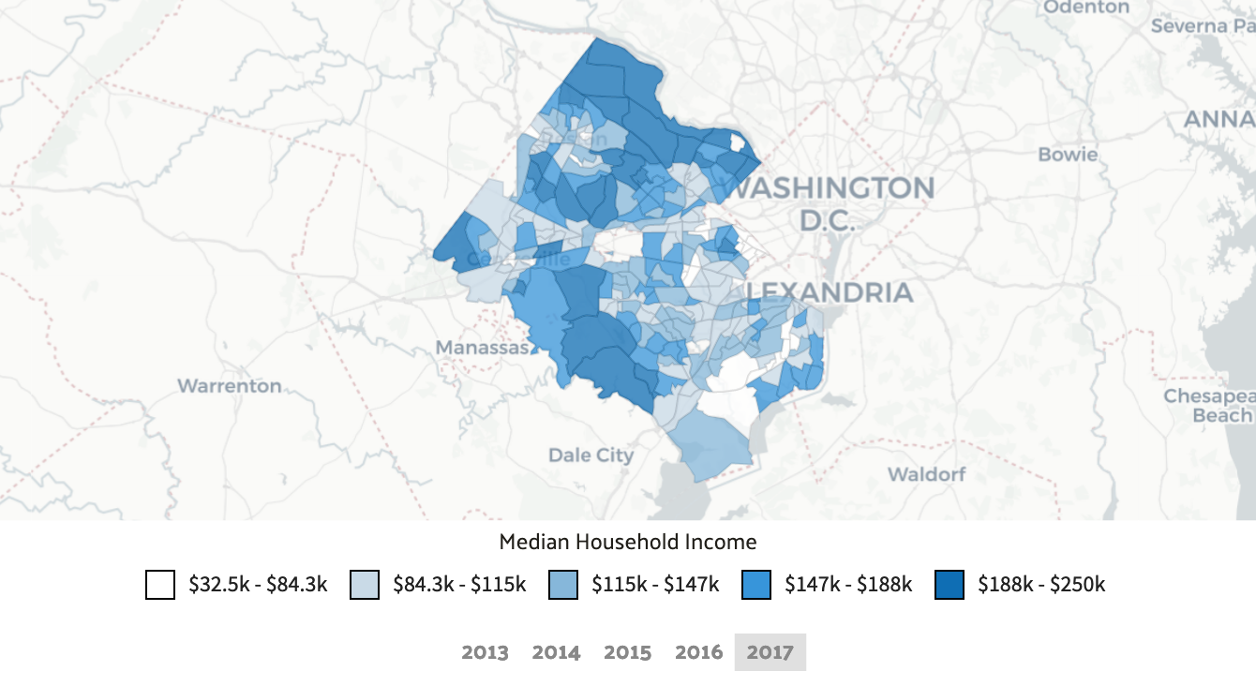

Slide 10
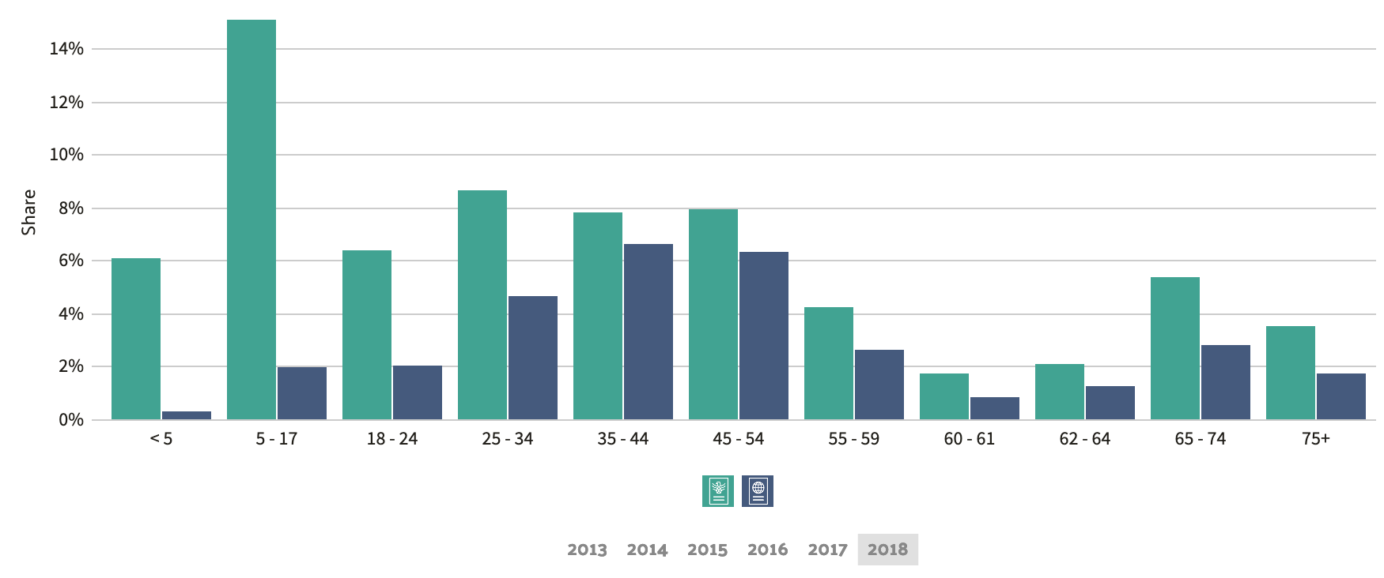
Population Demographics in Fairfax County
For the demographics in Fairfax, the median age
for native-born citizens is around 38 years old
whereas the average age for foreign-born
citizens is around 45 years old.

Slide 11
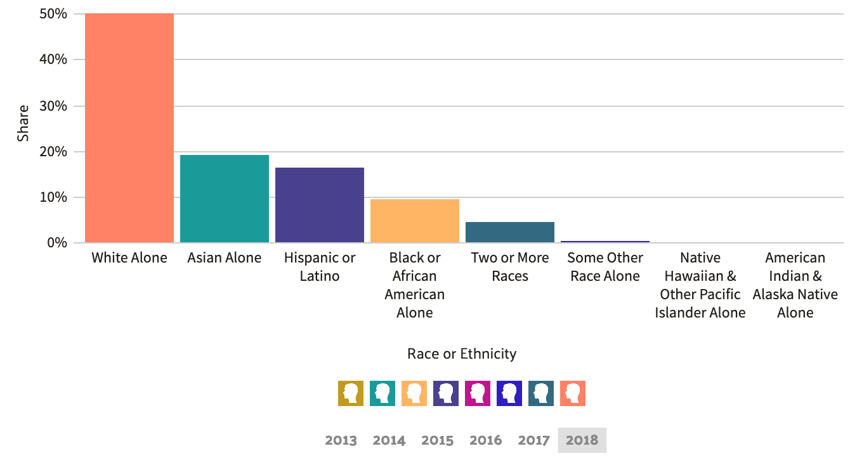
Population Demographics in Fairfax County (cont.)

Slide 12
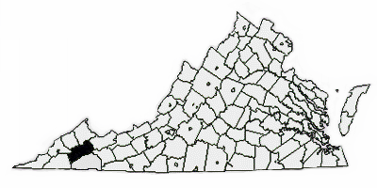
Background and History of Russell County
Russell County was established by Colonel William Russell from a section of Washington County in 1786.

Slide 13
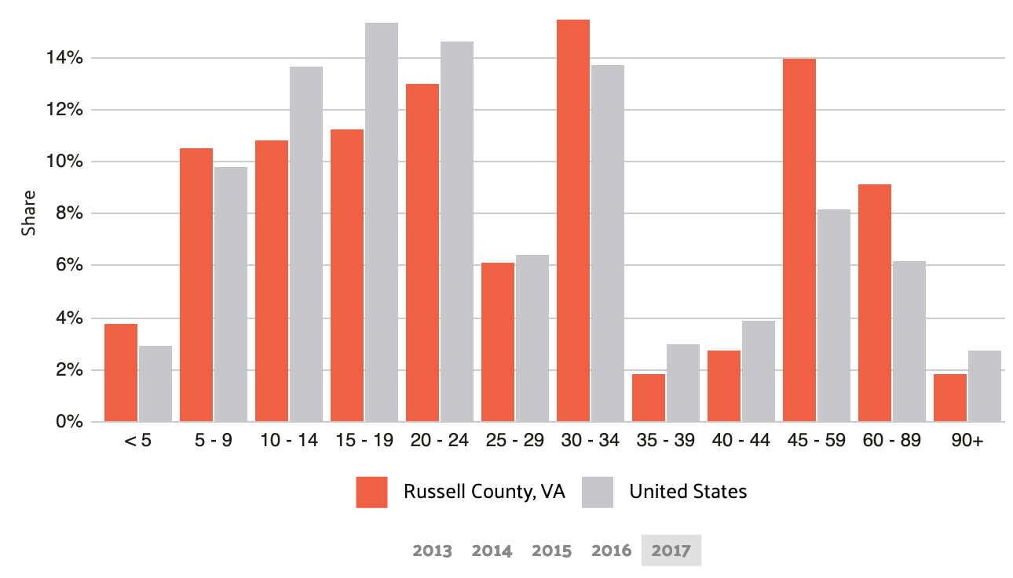
Commuting in Russell County
The average commute time in Russell County is
roughly 27 minutes, slightly longer than the
average commute time in the US.

Slide 14
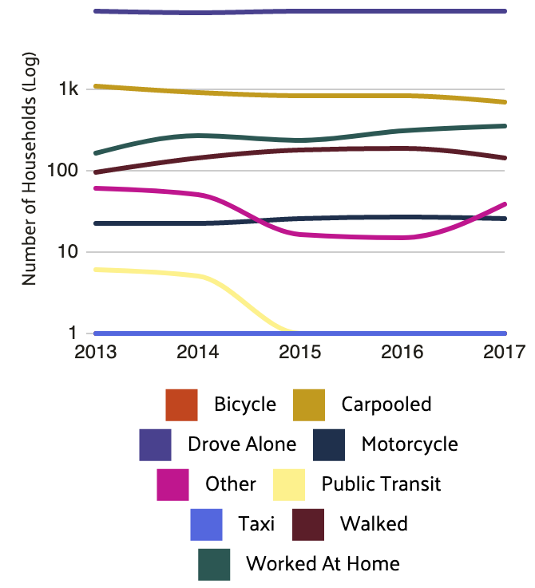
Commuting in Russell County
The most common method of transportation
was by driving alone with around 88% of
commuters preferring this, followed by roughly 7% of people
preferring to carpool.

Slide 15
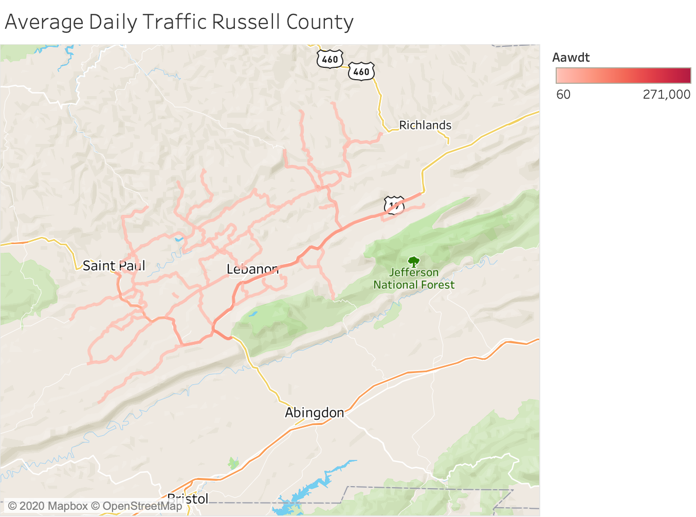
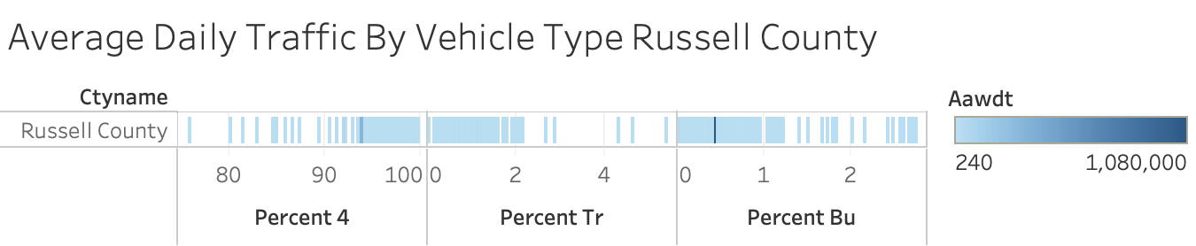
Traffic in Russell County
As you can see here, there is not a whole lot of
traffic in Russell County and that’s
because it is a mountainous area.
Just like Fairfax, most of the traffic
comes from 4-wheeled vehicles.

Slide 16
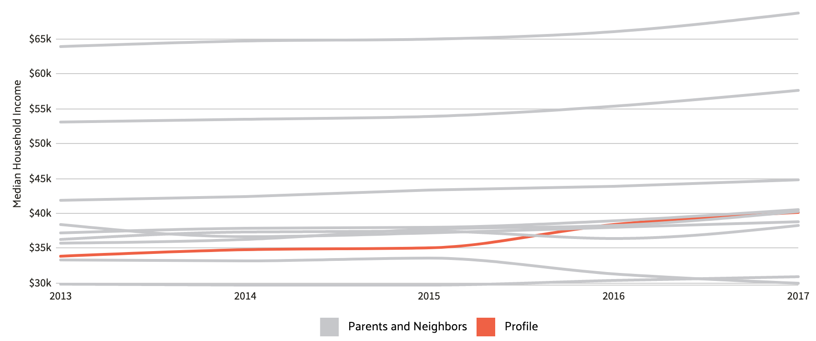
The Economy in Russell County
Russell County’s average household earns roughly
$40,083, with the highest income in the middle area
of Russell County

Slide 17
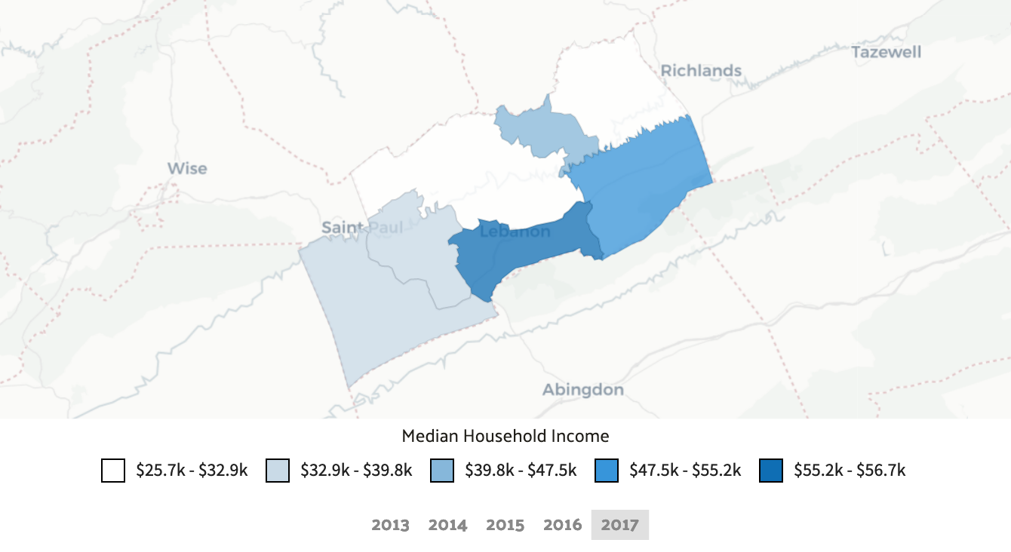
The Economy in Russell County(cont.)

Slide 18
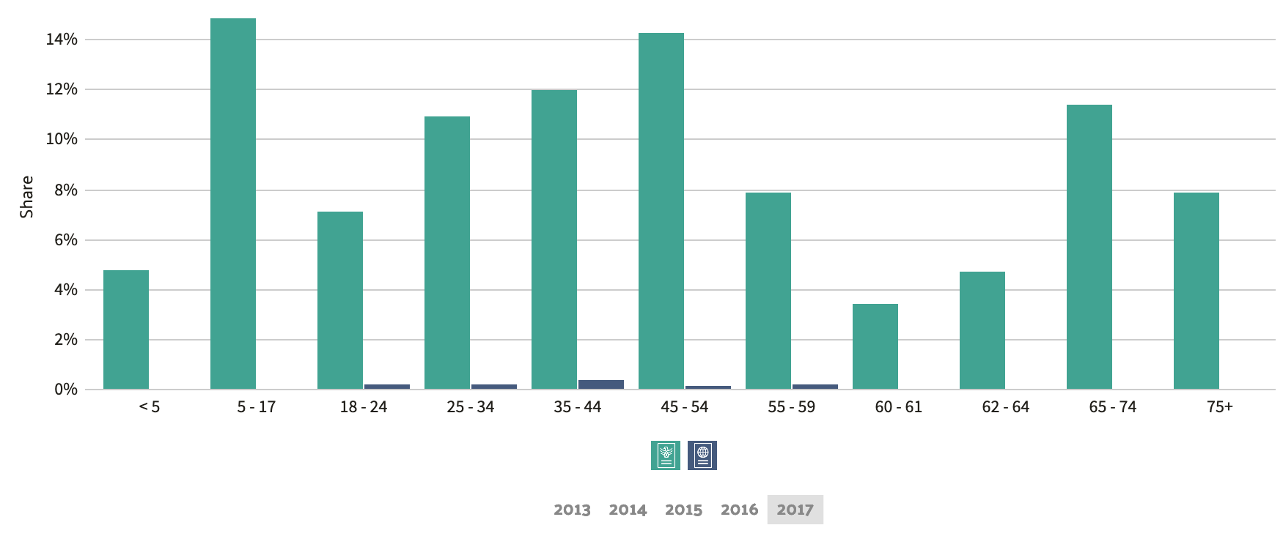
Population Demographics in Russell County
For the demographics in Russell County, the median age
for native-born citizens is around 45 years old whereas
the average age for foreign-born citizens is around 38 years old.

Slide 19
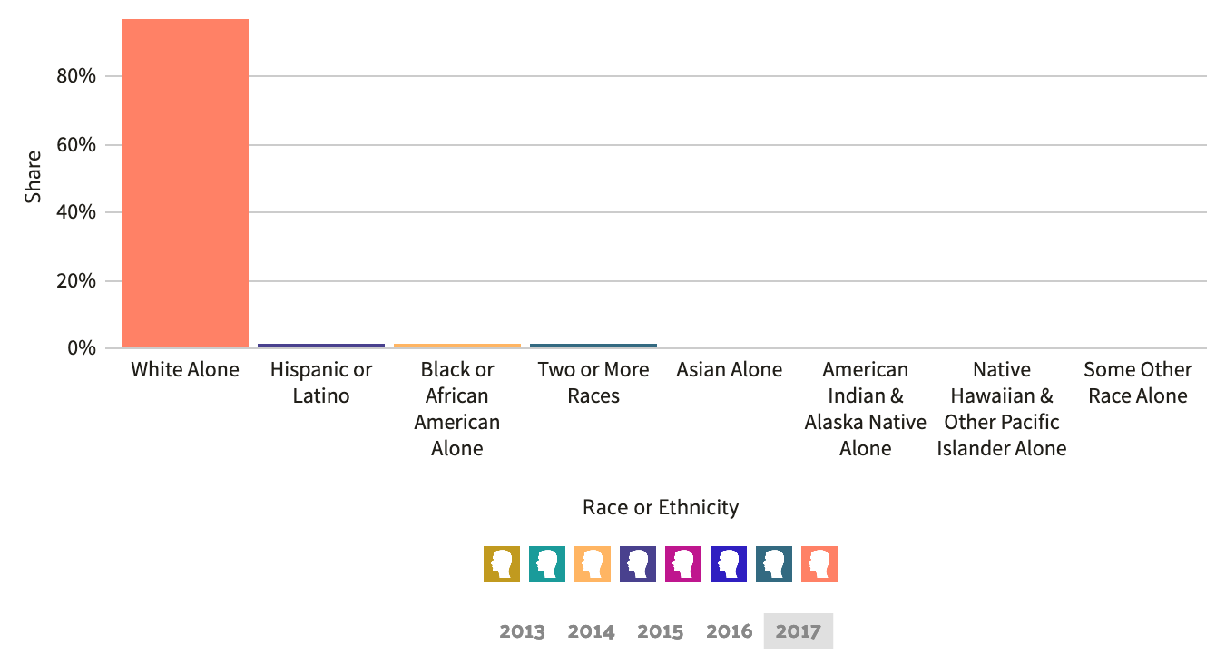
Population Demographics in Russell County (cont.)

Slide 20
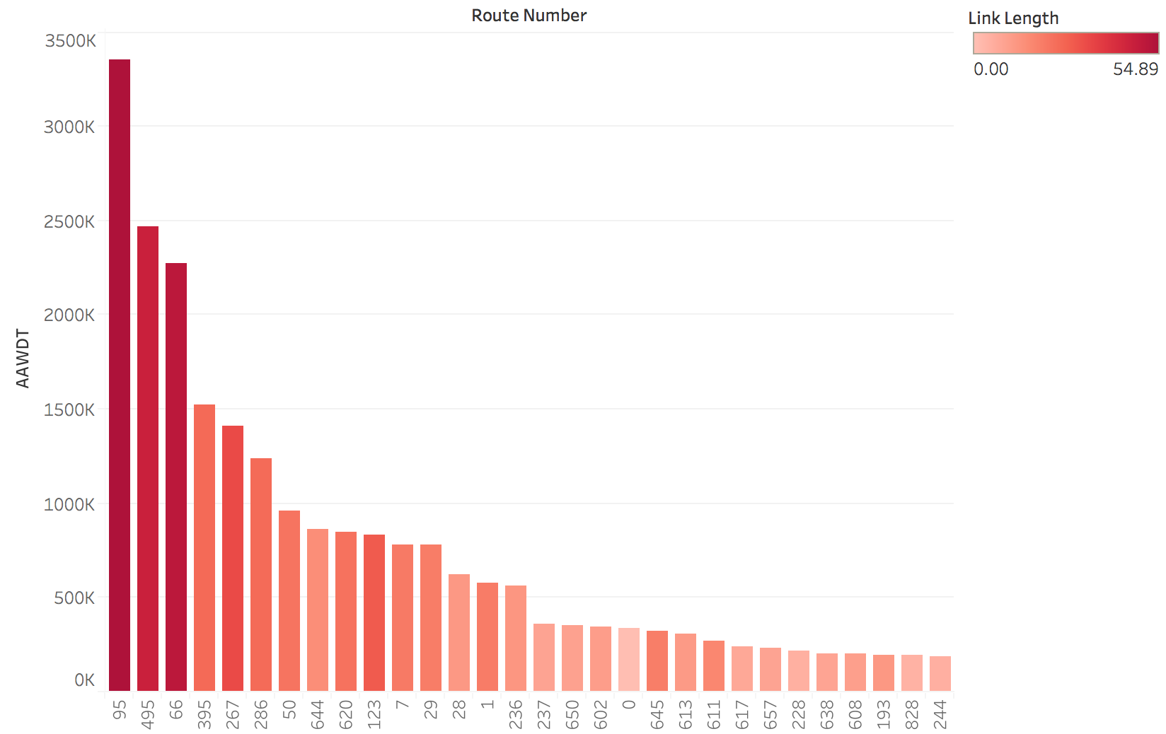
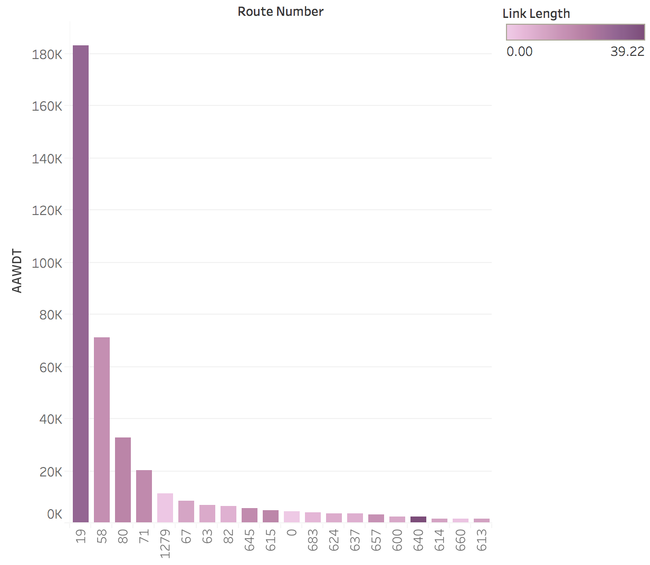
Fairfax County vs. Russell County
This graph shows the AAWDT for Fairfax County on the twenty most travelled route. The bars are also colored based on the length of the road showing that the darker red colors are the longer segments of roads.
The second graph shows the AAWDT for Russell County on the twenty most travelled routes. The bars are also colored based on the length of road showing that the darker purple colors indicate a longer road length.

Slide 21
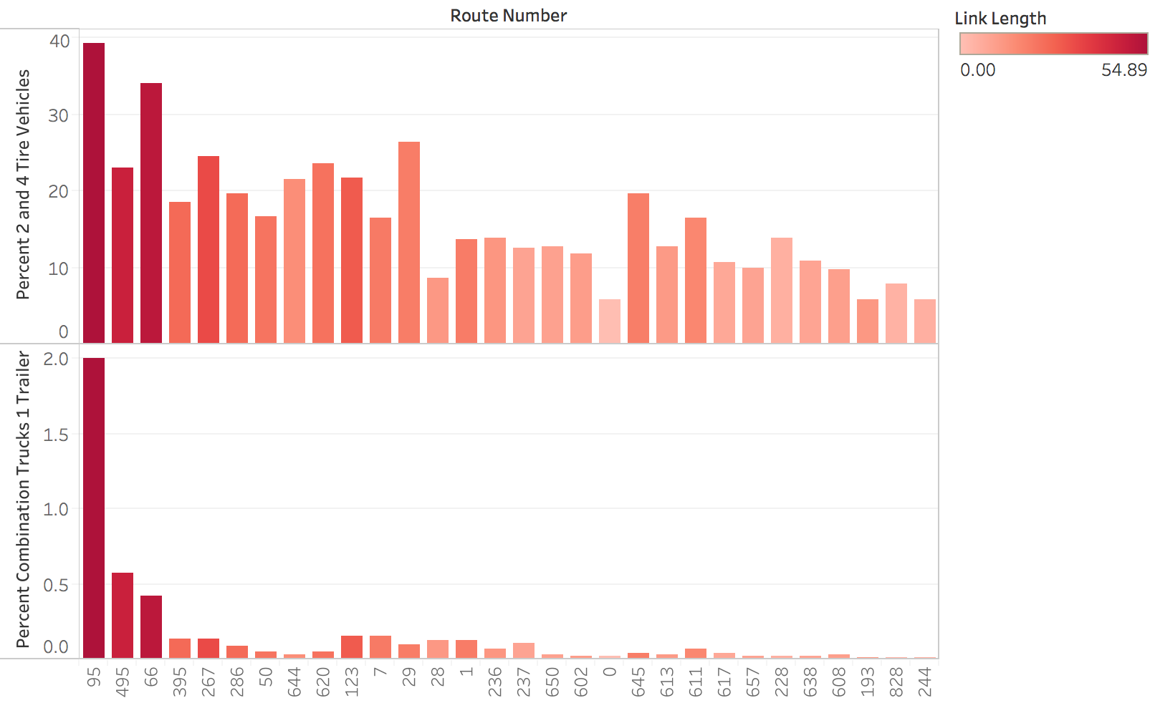
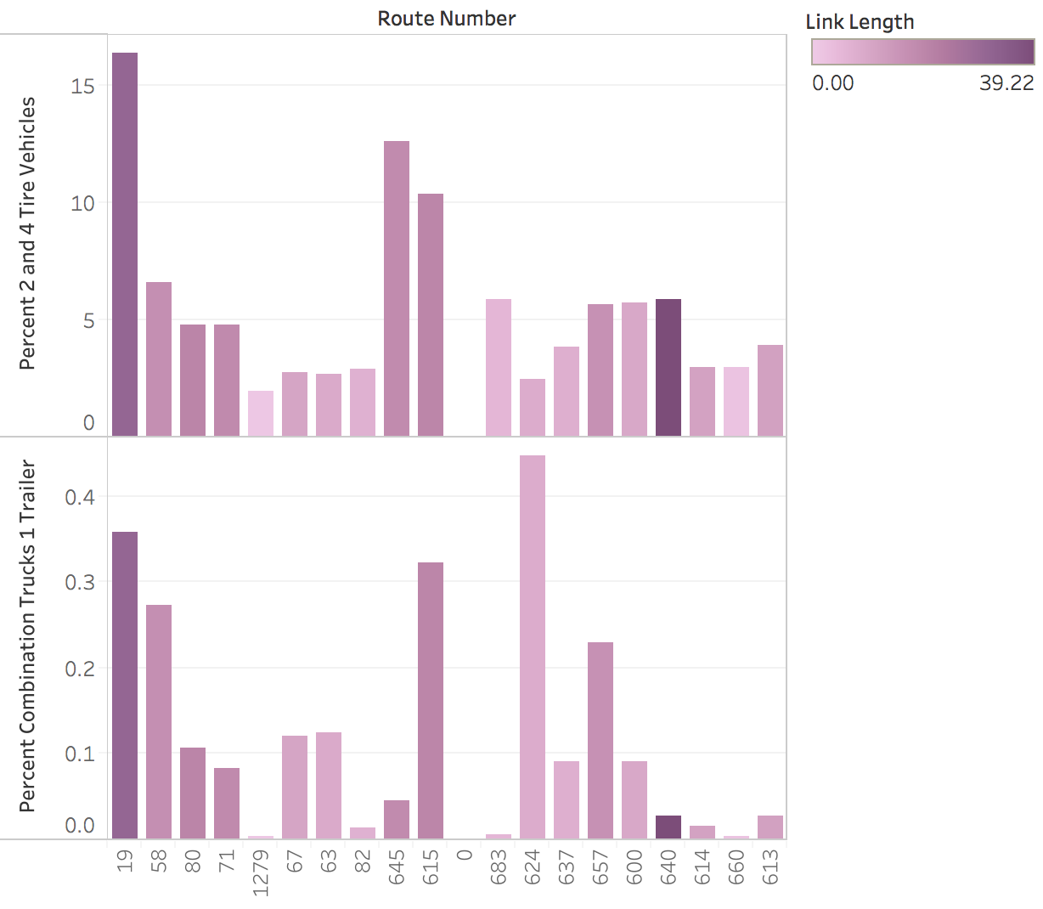
Fairfax County vs. Russell County
The percentage of traffic that is represented by 2 and 4 tire vehicles, and single trailer trucks for Fairfax County (left) and Russell County(right).

Slide 22
Conclusion
We have looked at and compared and contrasted both Fairfax and Russell Counties' traffic density of different types of vehicles along with any prominent patterns among the two areas and we also compared traffic volumes based on the type of days applied. We set out to try to find traffic patterns and differences in these traffic patterns between well populated areas and less populated areas. We found that as a general rule of thumb major highways and routes that span all the way across a county tend to be the most travelled. These major routes are also carrying the largest amounts of single truck trailers as they transport their goods cross country. Much of the conclusions we found are not very unexpected as anyone who has driven through large cities, highways, and small towns would have a basic idea of what they notice. Such as seeing trucks mostly on highways and small towns not really having large directing road networks to get drivers through efficiently since everything is so close together. Nonetheless, it was rewarding to be able to confirm much of our suspicions about traffic using real data and especially when it relates to us by being locally relevant data.

Slide 23
Bibliography
“Russell.” Russell - Virginia Is For Lovers, www.virginia.org/counties/Russell.
“History: Russell County, VA.” History | Russell County, VA, www.russellcountyva.us/199/History.
“Fairfax County.” Fairfax County - Virginia Is For Lovers, www.virginia.org/counties/Fairfax/.

Slide 24
Data Sources
https://www.fairfaxcounty.gov/demographics/commuting-patterns
https://www.fairfaxcounty.gov/demographics/fairfax-county-general-overview
https://datausa.io/profile/geo/russell-county-va
https://datausa.io/profile/geo/fairfax-county-va
https://www.virginiadot.org/info/2018_traffic_data_by_jurisdiction.asp

